Slide 1
Portable wheelchair ramp
By Team 3
Joseph Hoffman, Zachary Thornton, Milton Tomas, Akhil Patel

Slide 2
Overview
The goal for this project is to design a multipurpose portable wheelchair ramp that allows easy and quick access to a variety of vehicles. There are currently many ramps for wheelchairs users or wheelchair transporters, but there are no ramps that do both of these tasks. With a significant amount of people who cannot afford vehicles that support people with wheelchair disabilities, an affordable, effective wheelchair ramp is a necessity.

Slide 3
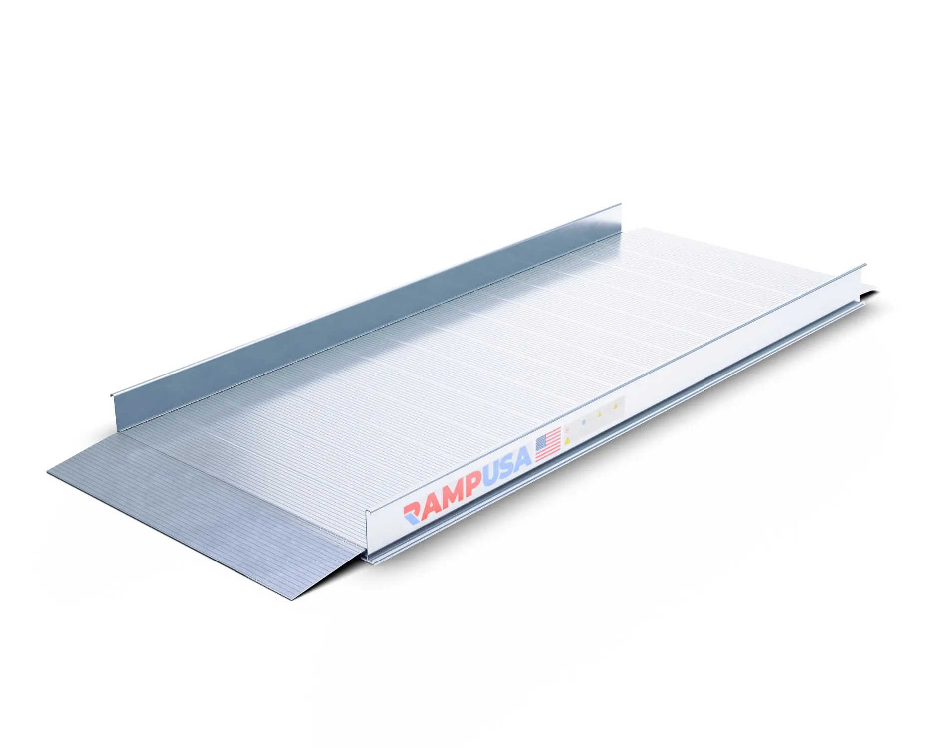
Market Research
The Easy Assist ramp
Weight Capacity: 1,000 lbs
Width: 36"
Length 4' to 10'
Handrail Height: 34.5"
Material: Aluminum
Installs in minutes
Cost: $242.00
https://medmartonline.com/easytrac-straight-modular-ramp?srsltid=AfmBOooCMZTOJDY82YkZNGXcFkdil0ynOwz76ie76EX7_n3yMjDDrAe1qkE

Slide 4
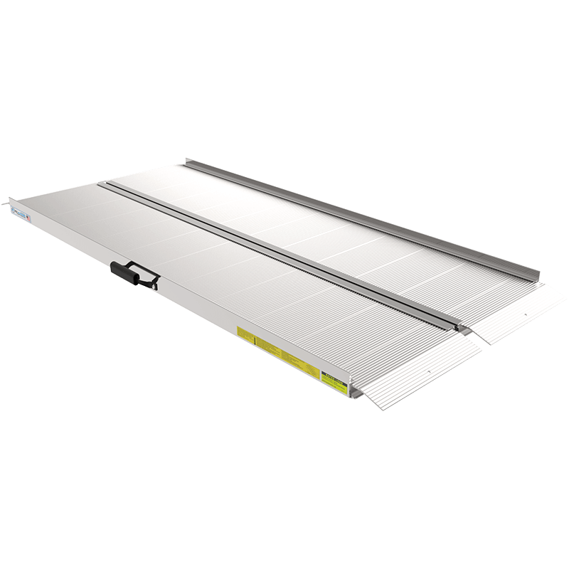
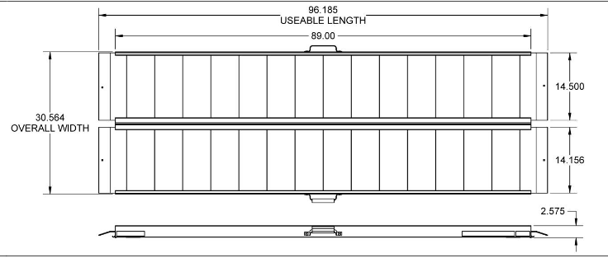
Market Research
The TRAVERSE Singlefold Ramp
Material : Aluminum
Rated Load : 1000-1200 lbs
Weight : 46.15 lbs.
Rated Load : 1000 lbs.
Usable Width : 30”
Folded Width : 15.28”
Overall Size :
96.185” x 30.25” x 2.575”
Cost: $315.99
https://www.ezaccess.com/products/traverse-singlefold-ramp

Slide 5
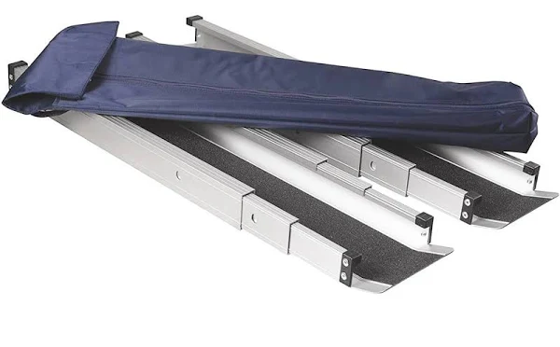
Market Research
DMI Telescoping Adjustable Wheelchair Ramp
Extended Length 60 in
Load Capacity 660 lb
Retracted Length 36 in
Usable Width 4 1/2 in
Cost $125.00

Slide 6
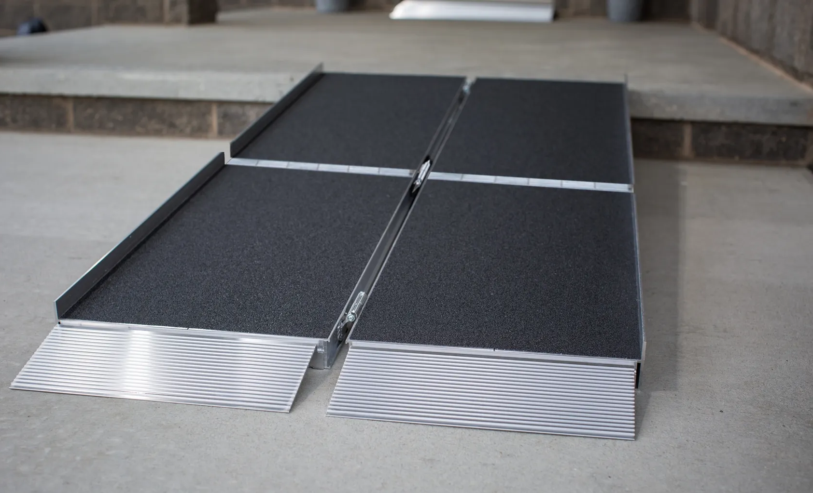
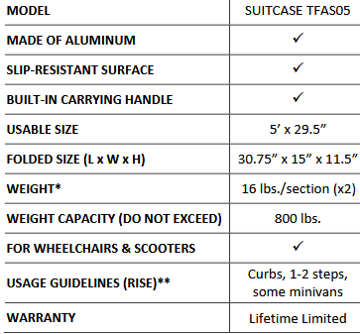
Market Research (TRIFOLD Portable Wheelchair Ramp)
Cost: $454.99
https://expressramps.com/trifold-portable-wheelchair-ramps

Slide 7
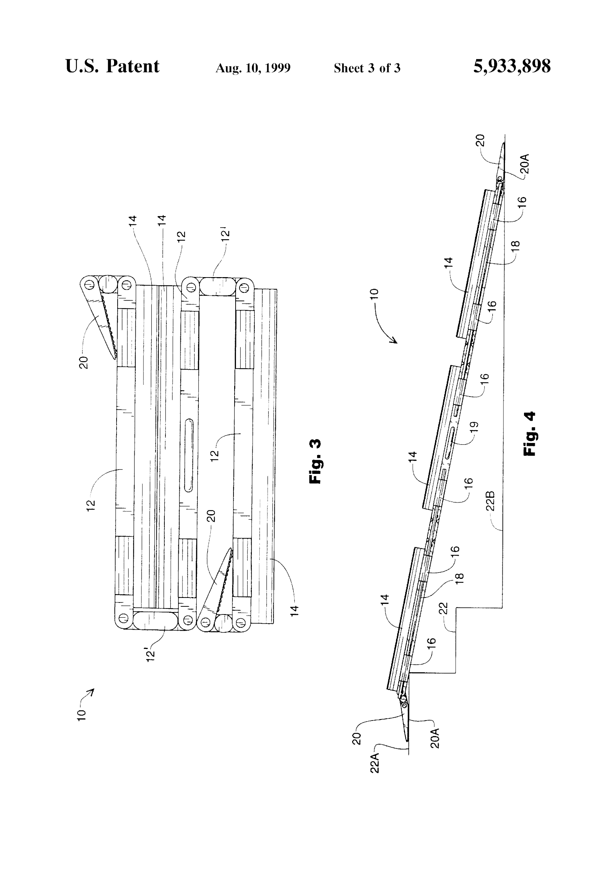
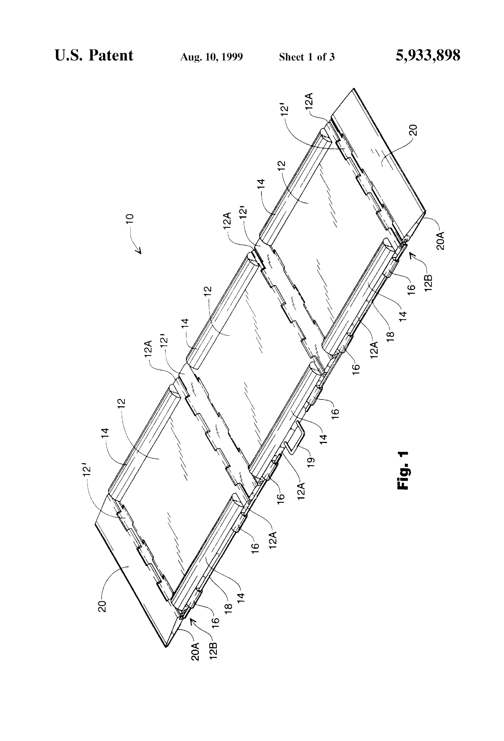
Patents
US5933898A (Portable wheelchair ramp)
Inventors: Kenneth Wayne Estes Lorinda Lee Estes
https://patents.google.com/patent/US5933898A/en
-This is a patent that used a folding system on a ramp for stairs.

Slide 8
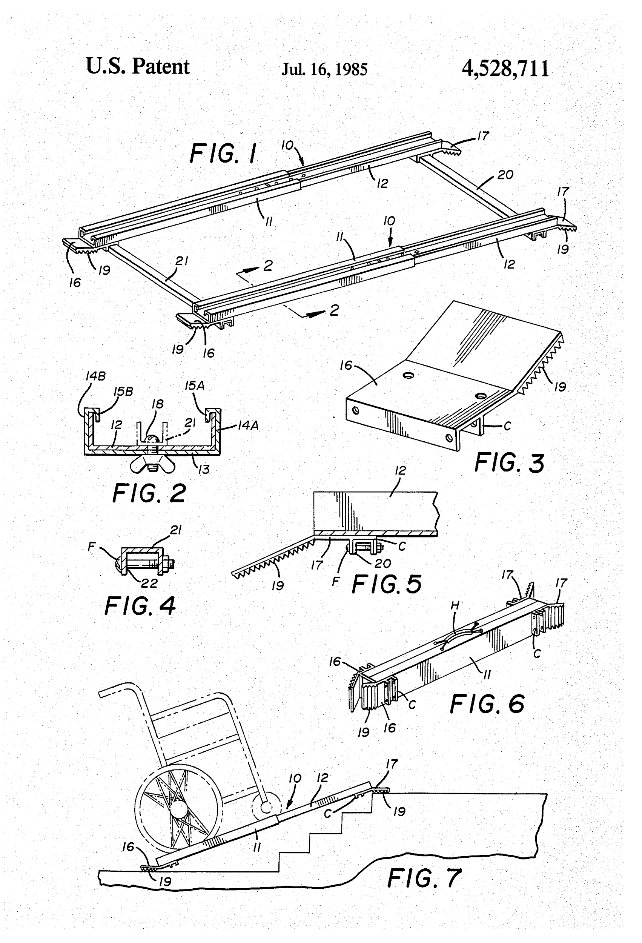
Patents
US4528711A (Portable wheelchair ramp)
Inventor: Louis Packer
A lightweight portable wheelchair ramp comprising a pair of ramps detachably secured to one another in a compact, portable configuration.
https://patents.google.com/patent/US4528711A/en

Slide 9
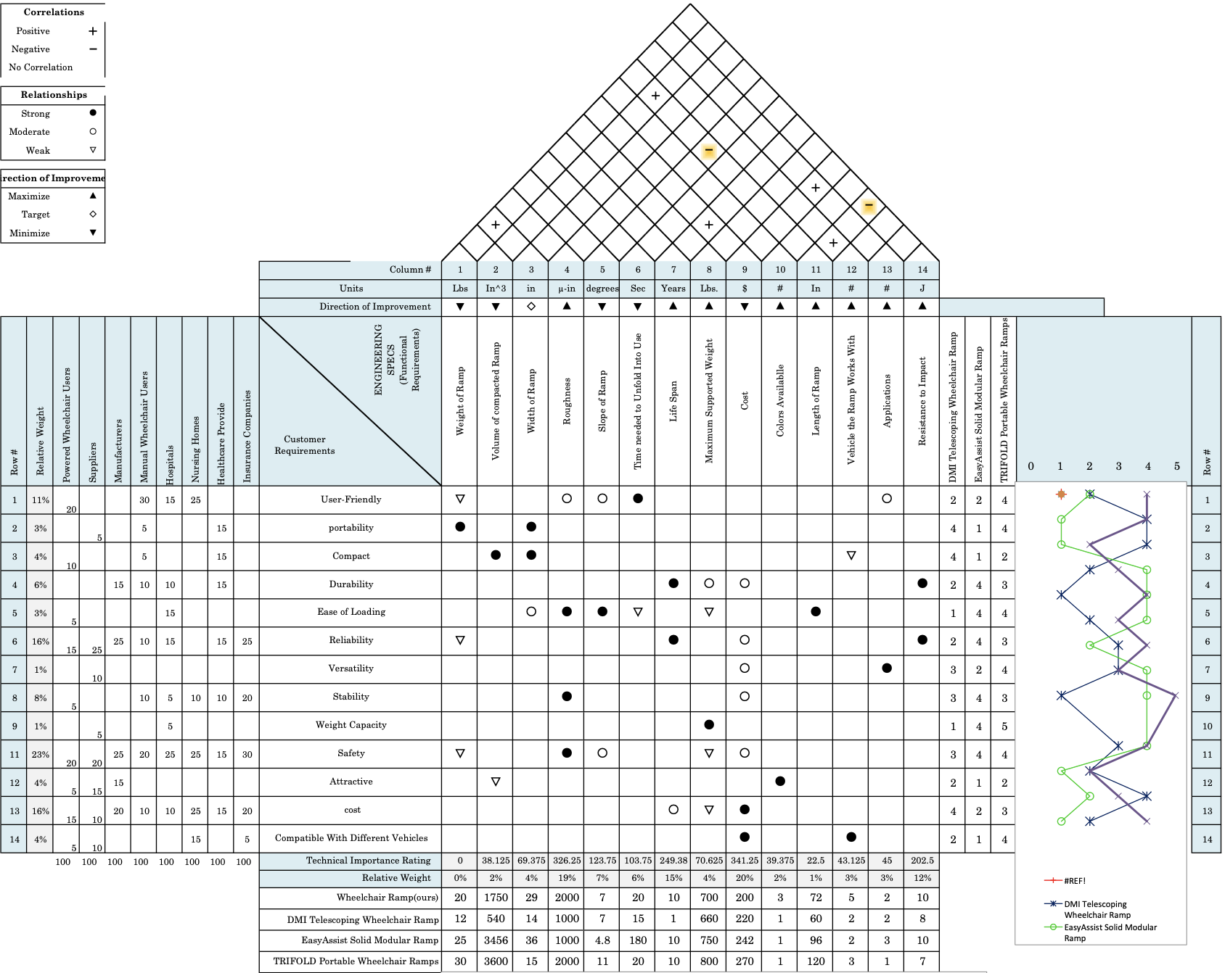
Full Portable Wheelchair Ramp QFD

Slide 10
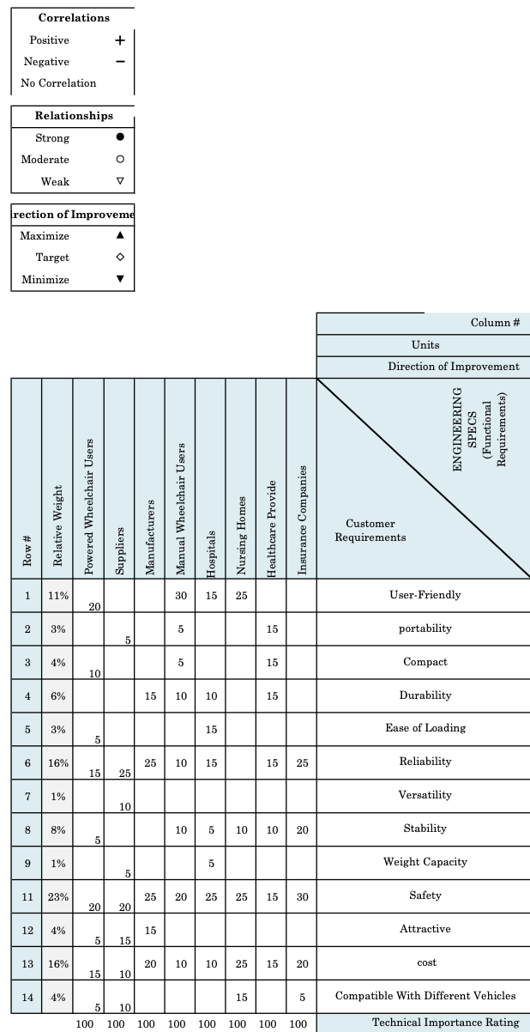
QFD: Customers and Customer Requirements
-The customers for the product are powered wheelchair users, manual wheelchair users, suppliers, manufacturers, hospitals, nursing homes, healthcare providers, and Insurance companies.

Slide 11
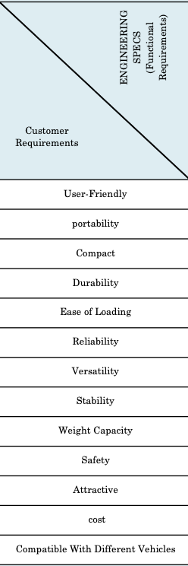
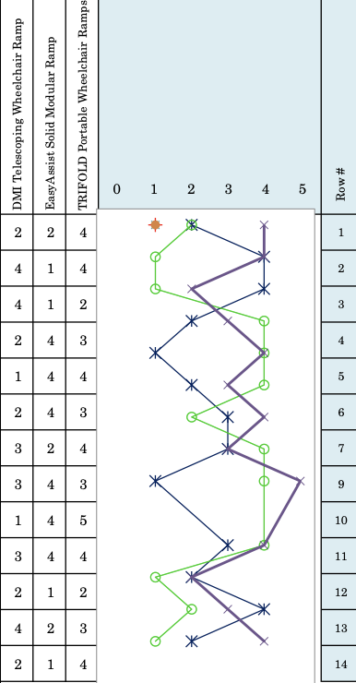
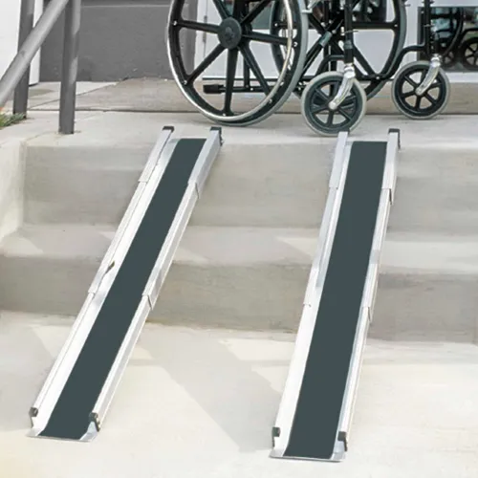
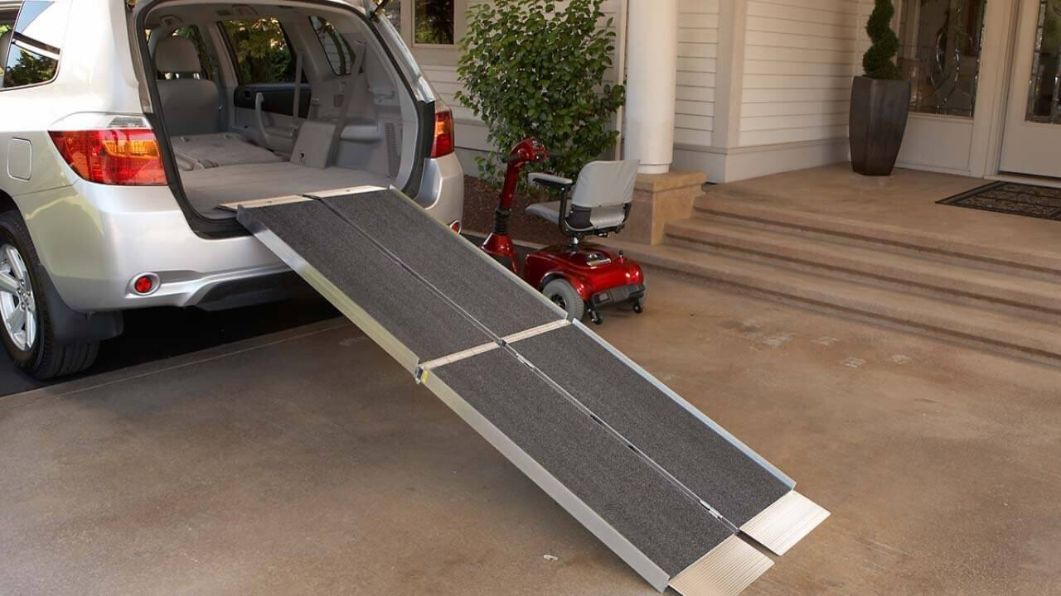
QFD: Competing Products
DMI Telescoping Wheelchair Ramp
EasyAssist Solid Modular Ramp
TRIFOLD Portable Wheelchair Ramps
-The TRIFOLD portable ramp was the best out of all of the competitors, However it was expensive and not as compact as the other ramps.
-The EasyAssist ramp did not perform as well as the competition. The product was not compact or portable.
-The DMI ramp was compact and versatile, but it was not as user friendly as the other ramps. The ramps would have to be put in the correct position depending on the width of the ramp.
Purple-TRIFOLD
Green- EasyAssist
Blue- DMI

Slide 12
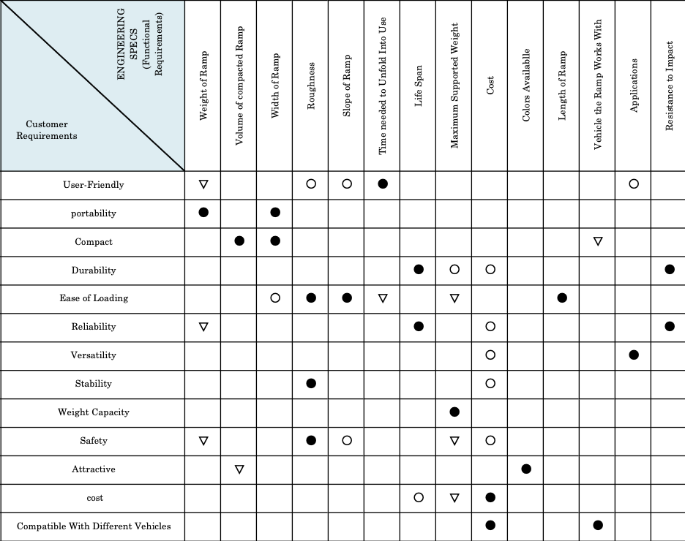
QFD: Engineering Specs and relations
The engineering specs include:
-Weight of the ramp in pounds.
-Volume of the folded ramp in inches cubed.
-Width of the ramp in inches.
-Roughness (traction) of the ramp in microinches.
-Slope of the ramp in degrees.
-Time needed to unfold the ramp in seconds.
-Life span of the ramp in years.
-Maximum supported weight in pounds.
-Cost of the ramp.
-Number of colors available.
-Length of the ramp in inches.
-Number of vehicles the ramp works with.
-Number of ways the ramp can be applied to anything related to wheelchairs.
-The resistance to impact in joules.

Slide 13
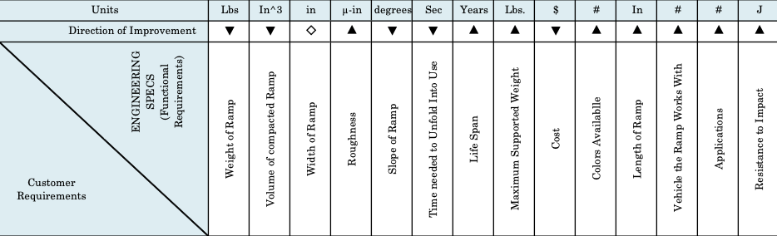
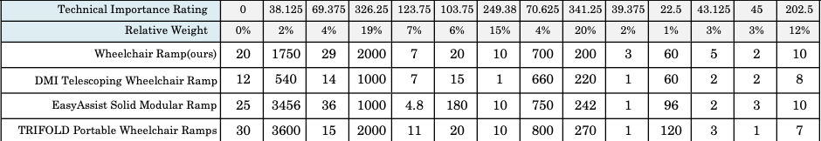
QFD: Targets
-The QFD helped set the target for the product. The targets for the portable wheelchair include:
-The ramp should be 20 pounds or less to be easy to move.
-The volume of the folded ramp should be 1750 in^3 or less to be as compact as possible.
-The width of the ramp should be at 29 inches to be suitable for most wheelchairs.
-The ramp should have at least a roughness score of 2000 microinches to maintain proper traction.
-The slope of the ramp should be around 7 inches to easily move up the ramp.
-The time needed to unfold the ramp should be at most 20 seconds to be user-friendly.
-The life span of the ramp should be at least 10 years.
-The ramp should be able to support 700 pounds to account for heavier electric wheelchairs.
-The ramp should cost $200 at most to make it an affordable option.
-The ramp should have at least 3 colors available so there is an attractive color for all buyers.
-The length of the ramp should be at least 60 inches to make the ramp easier to climb and resistant to impact.
-The ramp should fit at least 5 vehicles to make it compatible.
-The ramp should be able to complete at least two tasks related to the wheelchair.
-The ramp should be able to sustain an impact of at least 10 joules.

Slide 14
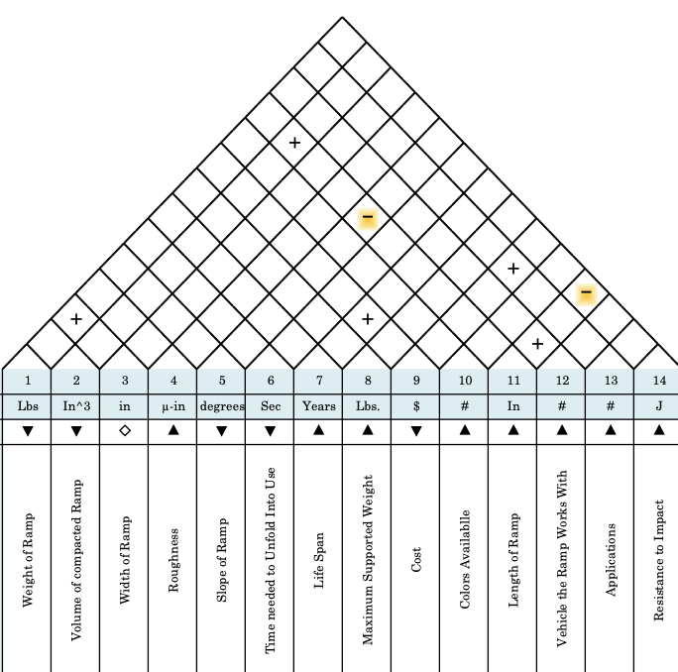
QFD: correlations
The two correlation that were present include:
-Length of ramp and slope of ramp. As the length of the ramp increases, the slope decreases.
-Length of the ramp and volume of the folded ramp. As the length of the ramp increases, the folded volume would increase as well.
-Life span and cost. As the cost increases, the life span increased as well.
-Weight of ramp and width of ramp. As width increased, the weight would increase as well.
-Cost and applications. As the cost increased, the applications would as well.
-Length of ramp and resistance to impact. As the length increases, the resistance to impact decreases

Slide 15
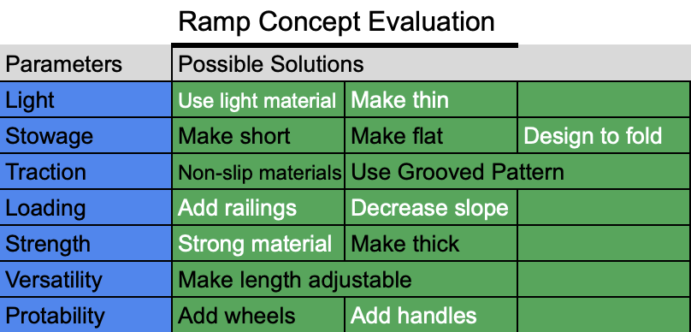
Concept generation methods
Brainstorming
-We each up came up with a different idea, which were presented in sketches. A total of four sketches were drawn.
Morphological table:

Slide 16
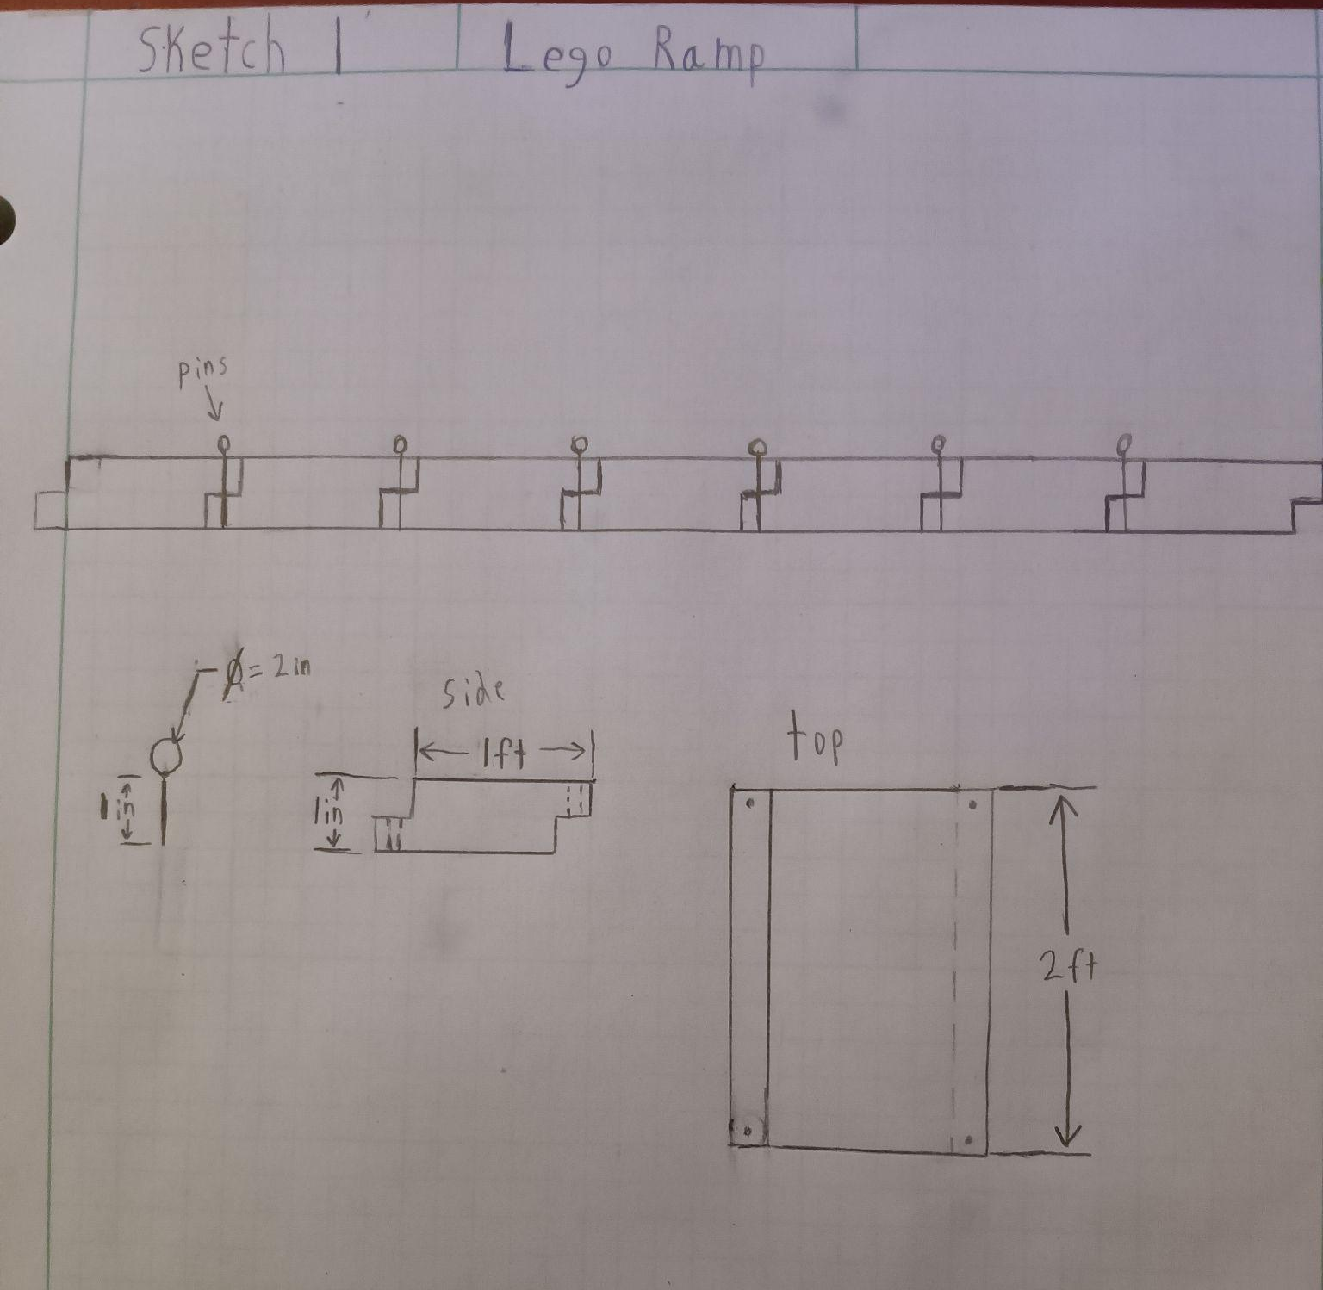
Sketch 1 - Lego ramp design
Ramp is comprised of sections held together by pins.
Pros:
-Variable length
-Strength
Cons:
-set up time
-Amount of pieces
-Storage

Slide 17
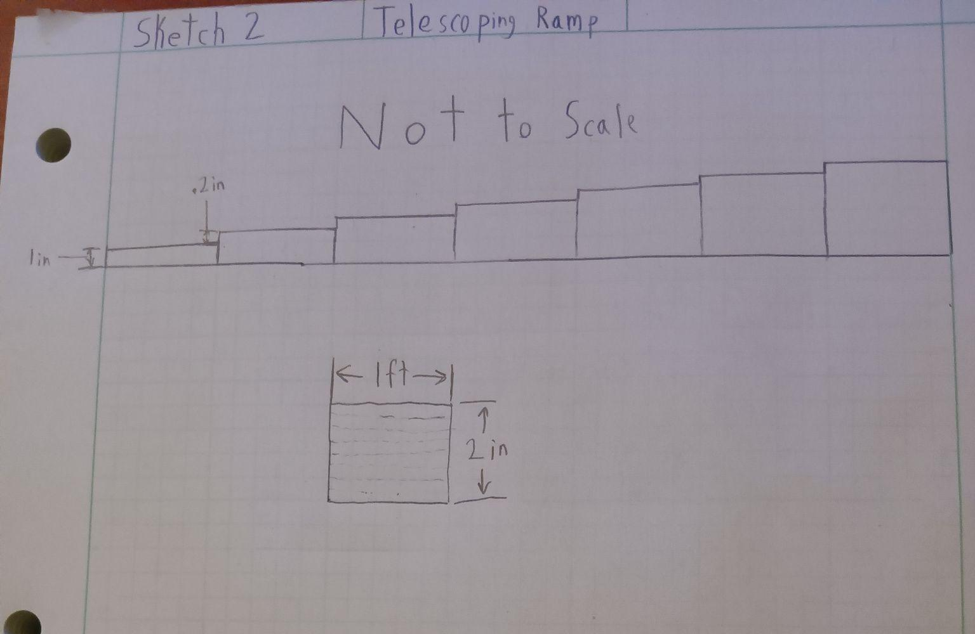
Sketch 2 - Telescoping Ramp
Fits in large box and slides out to full length.
Pros:
-compact
-Set up time
Cons:
-Strength
-No real locking mechanism
-2 inch “jump” at one end

Slide 18
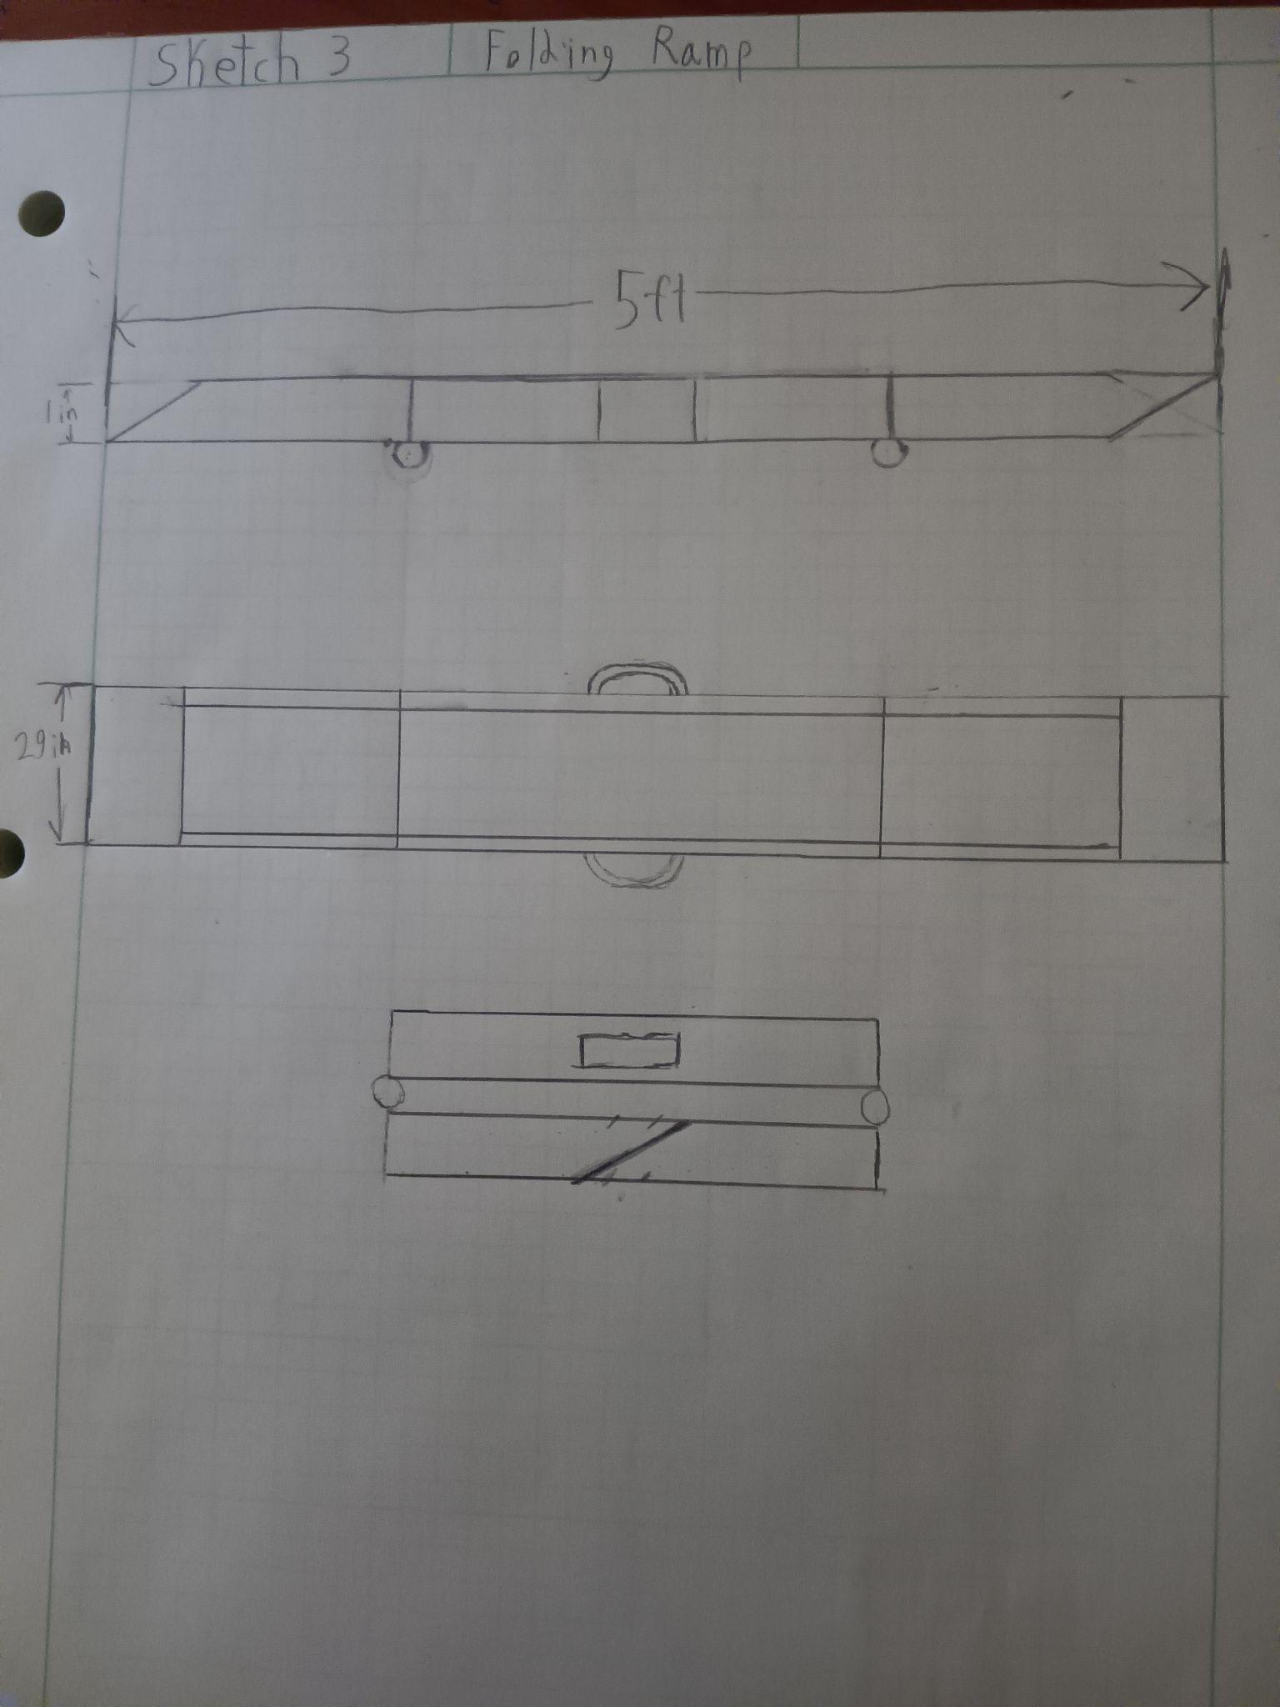
Sketch 3 - Folding ramp
The ramp folds in two places and has a handle on the sides.
Pros:
-Strength
-Reliability
-Set up time
Cons:
-The design is not as versatile as other options

Slide 19
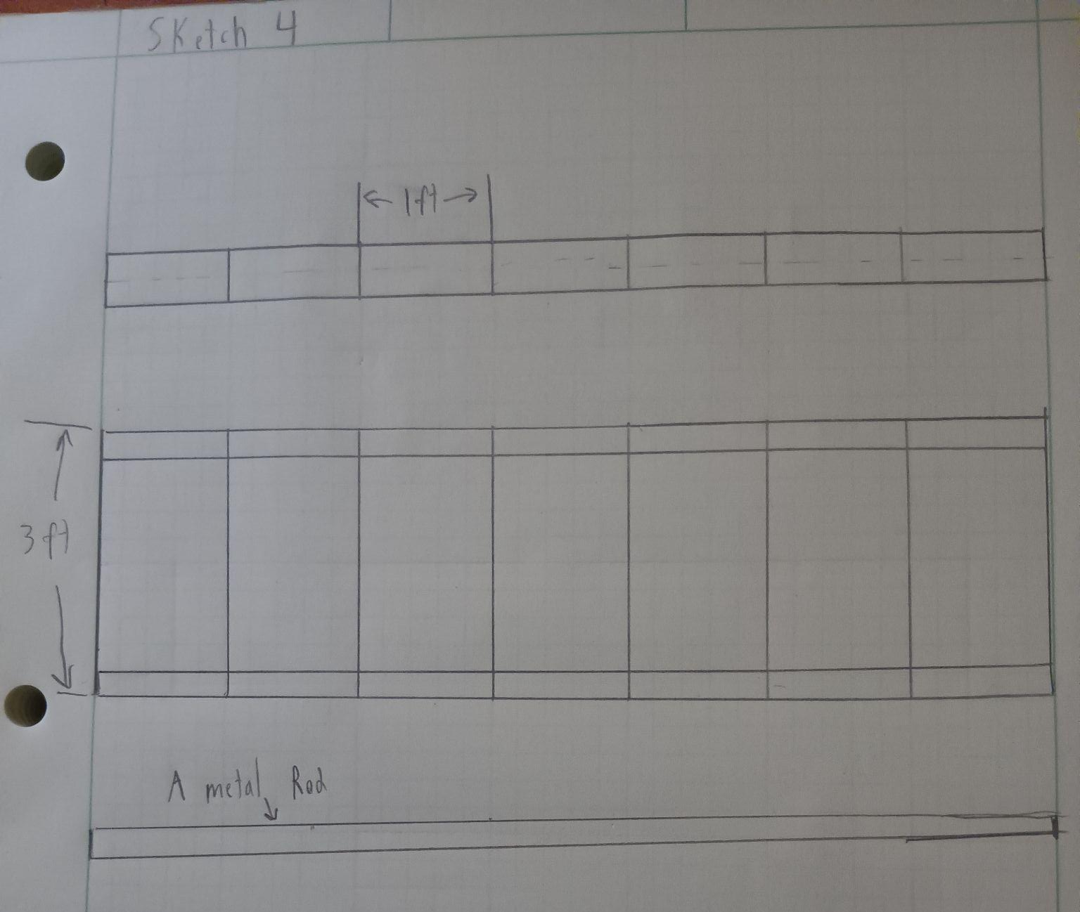
Sketch 4 - Slide on ramp
Slide on each 1 foot section on to two 7 foot metal rods that go through ramp side walls.
Pros:
-Strong
-Length of ramp
Cons:
-Set up time
-Pieces
-Not very compact

Slide 20
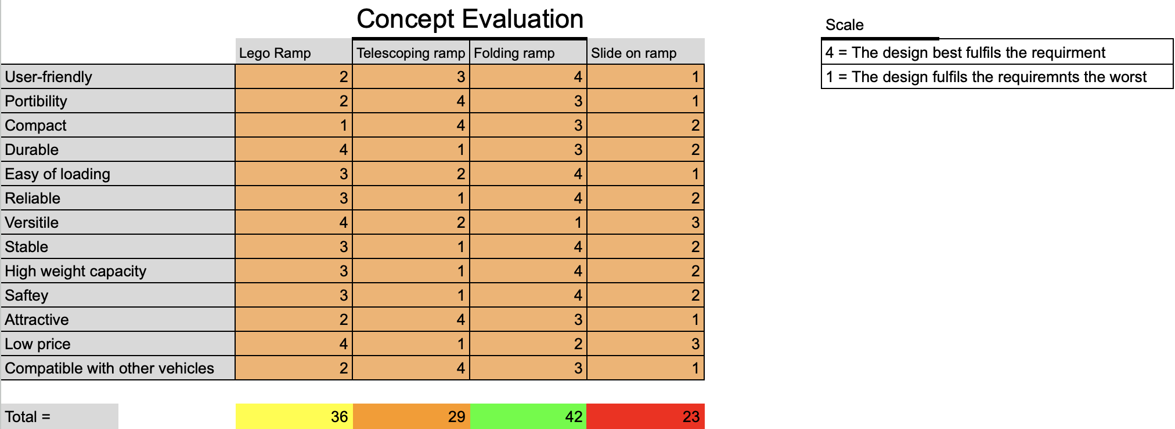
Concept evaluation
-Each design is awarded a number of points based on how well it completes the task.
-Based on the concept evaluation, the folding ramp is the best design.

Slide 21

Design choices - Treadplate Bump
- roughness (traction) to the surface. (slip resistance)
- This pattern is durable because it resists tearing, scratching, and adds good grip
-The pattern is easily cleanable, which makes it safer from lack of debrief.
- Corrosion resistance

Slide 22
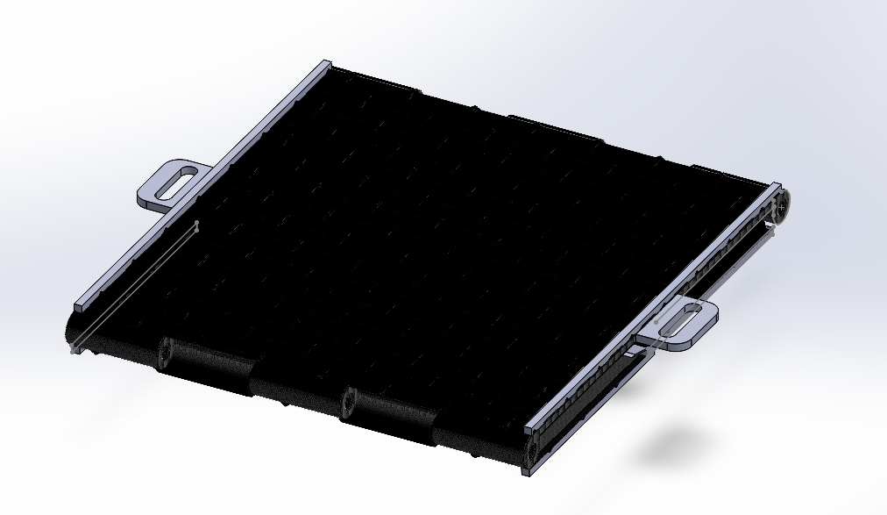
Folded Ramp
-The dimensions of the ramp are 30”length x 29” width x 4”height
Units: Inches

Slide 23
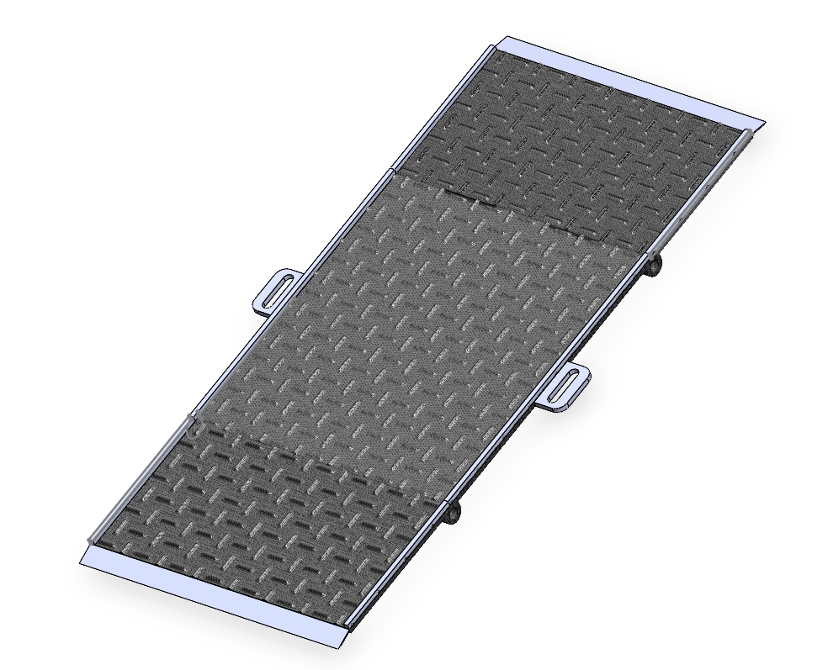
Final Design
-The extended ramp dimensions are 60” x 29” x 2”
-The ramp uses aluminum because it is a light and strong material.
-When placed on a car door frame, the slope angle is 7.2 degrees.
Must be under 12 degrees for someone in a wheelchair to use or else it will be too steep.

